Slide 1
Digital Logic Design
By Amr Al-Awamry
Lecture 10

Slide 2
Overview
Circuits require memory to store intermediate data
Sequential circuits use a periodic signal to determine when to store values.
A clock signal can determine storage times
Clock signals are periodic
Single bit storage element is a flip flop
A basic type of flip flop is a latch
Latches are made from logic gates
NAND, NOR, AND, OR, Inverter
Notes:
credential:
bring a computer
die photo
wafer
:
This can be an hidden slide. I just want to use this to do my own planning.
I have rearranged Culler’s lecture slides slightly and add more slides. This covers everything he covers in his first lecture (and more) but may
We will save the fun part, “ Levels of Organization,” at the end (so student can stay awake): I will show the internal stricture of the SS10/20.
Notes to Patterson: You may want to edit the slides in your section or add extra slides to taylor your needs.

Slide 3
The story so far ...
Logical operations which respond to combinations of inputs to produce an output.
Call these combinational logic circuits.
For example, can add two numbers. But:
No way of adding two numbers, then adding a third (a sequential operation);
No way of remembering or storing information after inputs have been removed.
To handle this, we need sequential logic capable of storing intermediate (and final) results.

Slide 4
Sequential Circuits
Inputs
Combinational circuit
Outputs
Flip Flops
Next state
Present state
Timing signal (clock)
Clock
a periodic external event (input)
Clock
synchronizes when current state changes happen
keeps system well-behaved
makes it easier to design and build large systems

Slide 5
Cross-coupled Inverters
A stable value can be stored at inverter outputs
State 1
State 2

Slide 6
S-R Latch with NORs
R (reset)
Q
S R Q Q’
1 1
1 0
0 1
0 0
0 0 Undefined
1 0 Set
0 1 Reset
Q
S (set)
0 1
Stable
1 0
S-R latch made from cross-coupled NORs
If Q = 1, set state
If Q = 0, reset state
Usually S=0 and R=0
S=1 and R=1 generates unpredictable results

Slide 7
S-R Latch with NANDs
S R Q Q’
S
Q
0 0
0 1
1 0
1 1
1 1 Disallowed
1 0 Set
0 1 Reset
Q’
0 1
R
Store
1 0
Latch made from cross-coupled NANDs
Sometimes called S’-R’ latch
Usually S=1 and R=1
S=0 and R=0 generates unpredictable results

Slide 8
S-R Latches

Slide 9
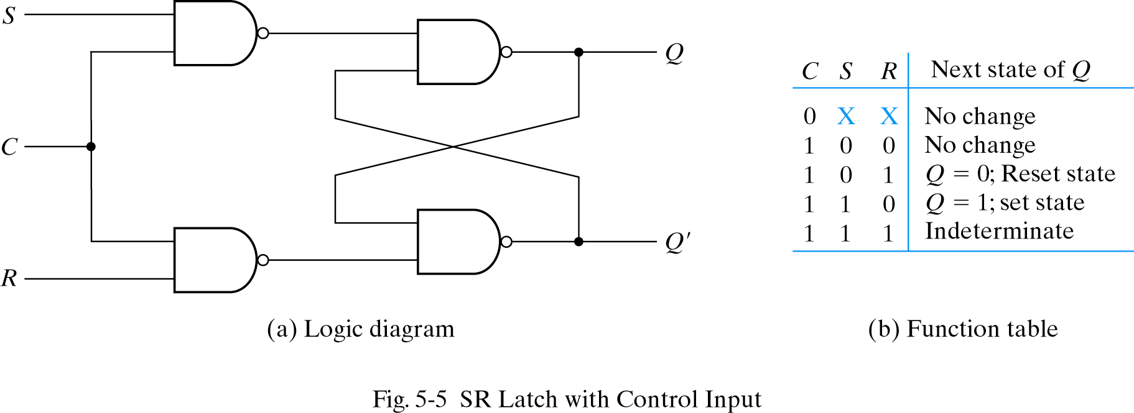
S-R Latch with control input
Occasionally, desirable to avoid latch changes
C = 0 disables all latch state changes
Control signal enables data change when C = 1
Right side of circuit same as ordinary S-R latch.

Slide 10
NOR S-R Latch with Control Input
Latch is level-sensitive, in regards to C
Only stores data if C’ = 0
R’
Q
C’
Latch operation enabled by
C
Q’
S’
Outputs change when C is low:
RESET and SET
Otherwise: HOLD
Input sampling enabled by gates

Slide 11
D Latch
Q₀ indicates the previous state (the previously stored value)
X
D
S
Q
C
Q’
Y
R
X Y C Q Q’
D C Q Q’
0 0 1 Q₀ Q₀’ Store
0 1 1 0 1 Reset
1 0 1 1 0 Set
1 1 1 1 1 Disallowed
X X 0 Q₀ Q₀’ Store
0 1 0 1
1 1 1 0
X 0 Q₀ Q₀’

Slide 12
D Latch
X
D
S
Q
C
Q’
Y
R
D C Q Q’
0 1 0 1
1 1 1 0
X 0 Q₀ Q₀’
Input value D is passed to output Q when C is high
Input value D is ignored when C is low

Slide 13
D Latch
Latches on following
edge of clock
E
x
D
Q
x
z
E
C
z
Z only changes when E is high
If E is high, Z will follow X

Slide 14
D Latch
Latches on following
edge of clock
E
x
D
Q
x
z
E
C
z
The D latch stores data indefinitely, regardless of input D values, if C = 0
Forms basic storage element in computers

Slide 15
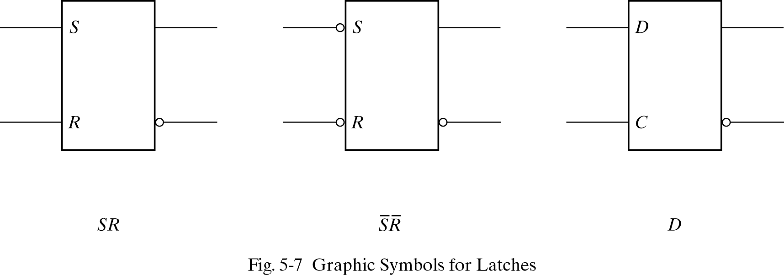
Symbols for Latches
SR latch is based on NOR gates
S’R’ latch based on NAND gates
D latch can be based on either.
D latch sometimes called transparent latch

Slide 16
Summary
Latches are based on combinational gates (e.g. NAND, NOR)
Latches store data even after data input has been removed
S-R latches operate like cross-coupled inverters with control inputs (S = set, R = reset)
With additional gates, an S-R latch can be converted to a D latch (D stands for data)
D latch is simple to understand conceptually
When C = 1, data input D stored in latch and output as Q
When C = 0, data input D ignored and previous latch value output at Q
Next time: more storage elements!
Notes:
credential:
bring a computer
die photo
wafer
:
This can be an hidden slide. I just want to use this to do my own planning.
I have rearranged Culler’s lecture slides slightly and add more slides. This covers everything he covers in his first lecture (and more) but may
We will save the fun part, “ Levels of Organization,” at the end (so student can stay awake): I will show the internal stricture of the SS10/20.
Notes to Patterson: You may want to edit the slides in your section or add extra slides to taylor your needs.

